Slide 1

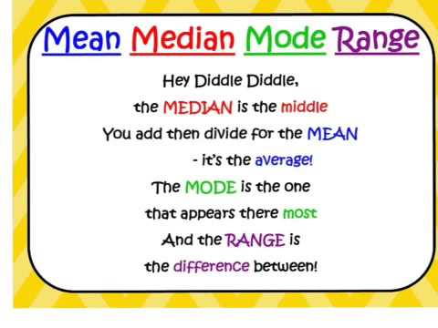
My Statistics Interactive Notebook
Name:
Class:
Term 3 Semester 2

Slide 2
Lesson Objectives
To be able to construct a back to back Stem and Leaf plot, and use it to identify differences in data sets

Slide 3
24
7
30
Date
Back to Back Stem and Leaf Plots
EQ – How can I use a stem and leaf plot to compare two sets of data
What are back to back
Stem and Leaf Plots?
Back to back stem and leaf plots are used to display two different groups of data together in the one plot.
The groups are displayed separately but share a common stem.
One group is displayed on the left hand side, the other on the right hand side.

Slide 4
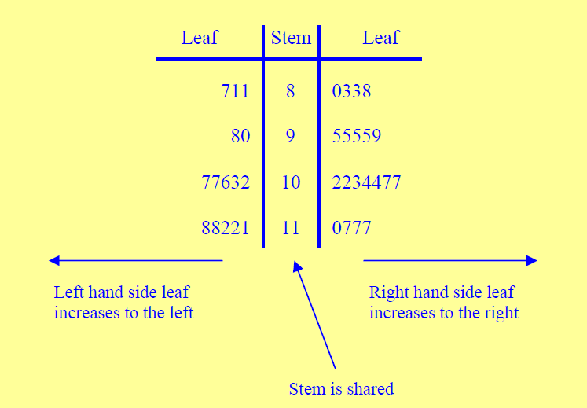
24
7
30
Date
Back to Back Stem and Leaf Plots
EQ – How can I use a stem and leaf plot to compare two sets of data
What are back to back
Stem and Leaf Plots?
Back to back stem and leaf plots are used to display two different groups of data together in the one plot.
The groups are displayed separately but share a common stem.
One group is displayed on the left hand side, the other on the right hand side.
No Commas!

Slide 5

Stem and Leaf Diagrams
Here are the ages of patients on admission to a hospital
Males: 2 13 24 39 45 45 48 56 58 59 59 62 64 64 68 69
Females: 1 12 14 23 28 37 39 39 42 42 45 46 51 57 58 63 65 71 88
0
1
2
3
4
5
6
7
8

Slide 6
Stem and Leaf Diagrams
Here are the ages of patients on admission to a hospital
Males: 2 13 24 39 45 45 48 56 58 59 59 62 64 64 68 69
Females: 1 12 14 23 28 37 39 39 42 42 45 46 51 57 58 63 65 71 88
2
3
4
0
1
2
3
4
5
6
7
8

Slide 7
Stem and Leaf Diagrams
Here are the ages of patients on admission to a hospital
Males: 2 13 24 39 45 45 48 56 58 59 59 62 64 64 68 69
Females: 1 12 14 23 28 37 39 39 42 42 45 46 51 57 58 63 65 71 88
2
3
4
9
8 5 5
9 9 8 6
9 8 6 4 4 2
1
2 4
3 8
7 9 9
2 2 5 6
1 7 8
3 5
1
8
0
1
2
3
4
5
6
7
8
4|2 = 52

Slide 8
Stem and Leaf Diagrams
Here are the ages of patients on admission to a hospital
Range = ?
2
3
4
9
8 5 5
9 9 8 6
9 8 6 4 4 2
1
2 4
3 8
7 9 9
2 2 5 6
1 7 8
3 5
1
8
0
1
2
3
4
5
6
7
8
4|2 = 52

Slide 9
Stem and Leaf Diagrams
Here are the ages of patients on admission to a hospital
Range = Highest – Lowest = 88 – 1 = 87
2
3
4
9
8 5 5
9 9 8 6
9 8 6 4 4 2
1
2 4
3 8
7 9 9
2 2 5 6
1 7 8
3 5
1
8
0
1
2
3
4
5
6
7
8
4|2 = 52

Slide 10
Stem and Leaf Diagrams
Here are the ages of patients on admission to a hospital
What else do you notice about the data sets? Does one seem more symmetrical?
2
3
4
9
8 5 5
9 9 8 6
9 8 6 4 4 2
1
2 4
3 8
7 9 9
2 2 5 6
1 7 8
3 5
1
8
0
1
2
3
4
5
6
7
8
4|2 = 52

Slide 11
Stem and Leaf Diagrams
Here are the ages of patients on admission to a hospital
What else do you notice about the data sets? Does one seem more symmetrical?
2
3
4
9
8 5 5
9 9 8 6
9 8 6 4 4 2
1
2 4
3 8
7 9 9
2 2 5 6
1 7 8
3 5
1
8
0
1
2
3
4
5
6
7
8
4|2 = 52

Slide 12
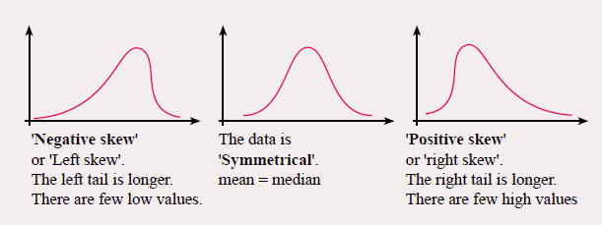
2
3
4
9
8 5 5
9 9 8 6
9 8 6 4 4 2
1
2 4
3 8
7 9 9
2 2 5 6
1 7 8
3 5
1
8
0
1
2
3
4
5
6
7
8
4|2 = 52

Slide 13
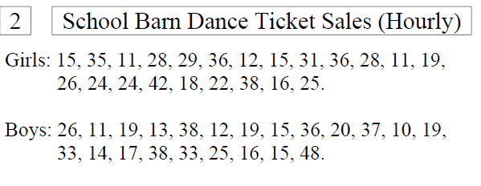
Try these on your own. Use your notes if you need to.
Use a Stem and Leaf Plot to represent the following data. Find the median and mode. Comment on any differences between the data sets.

Slide 14
Complete your Summary ensuring you explain the process you use to find the measures of location.

Slide 15
Notes Review
24, 7 ,30
Date
Title
Essential question
Notes complete
Notes complete with colour and diagrams
Questions completed
Contents page filed in
Formula page filled in

Slide 16
Homework
Review your notes and write a summary answering the essential question.

